Slide 1

Data analysis
Dr Alveen Singh
Department of Information Technology
Research skills
Advanced Diploma in ICT
Semester 1 2022

Slide 2

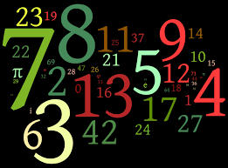


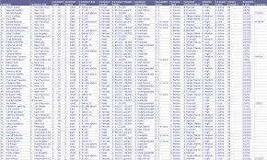
Introduction
Data can emanate from numerous and differing types of sources

Slide 3
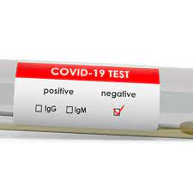
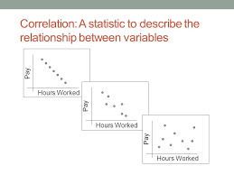
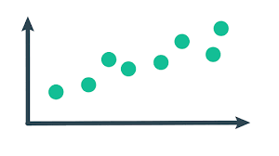
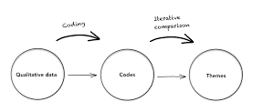
Data analysis is the process of cleaning, transforming, and modelling data to identify patterns, trends and themes.
Data analysis is performed to identify connections, and relationships in the data.
Stated more simply, the purpose of data analysis is to extract useful information from the data.
Slideplayer.net
Nngroup.com

Slide 4
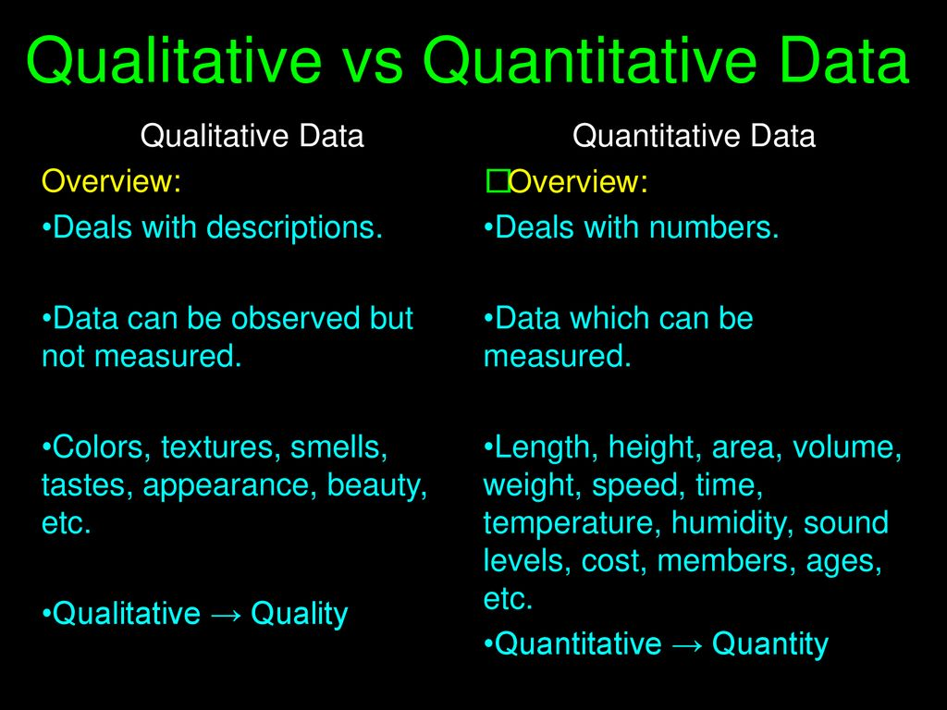
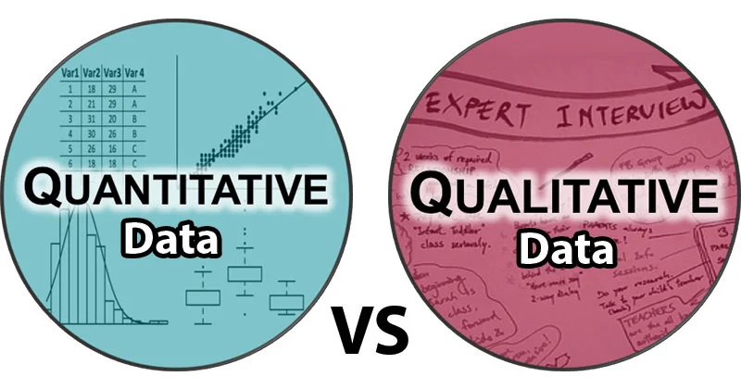
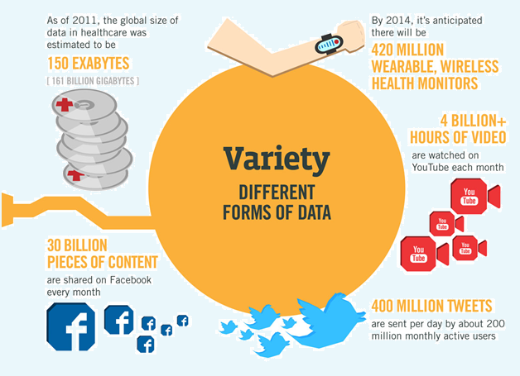
Harrison, 2019
Different types of data
Microbenotes.com
Knowforgrow,2016

Slide 5
Structured and unstructured data
Structured data: neat, organized and structured
Unstructured data: needs to be organized or formatted before analysis
“Estimates say that just 20% of data is structured, while unstructured data accounts for 80% of data regularly generated” (Mesevage, 2020)

Slide 6
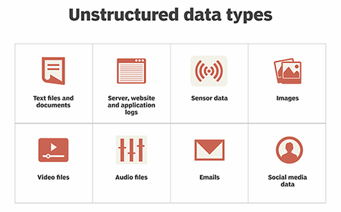
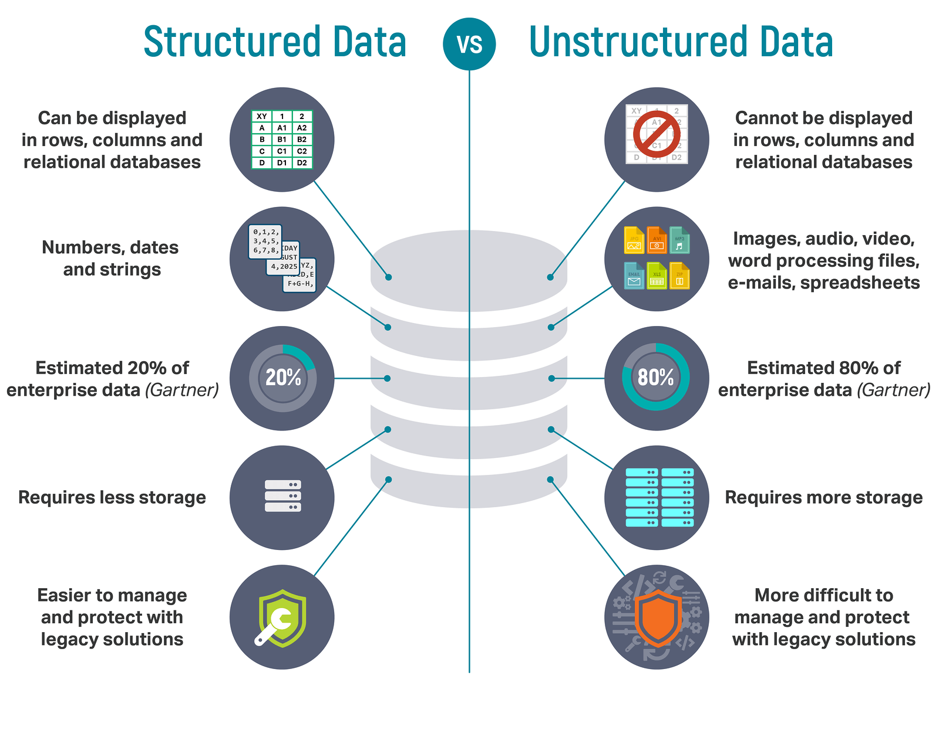

Hanna and Stedman, 2021
igneous.io/blog
lawtomated.com

Slide 7
2. Analysing qualitative data
Collected during interviews, focus groups or open-ended questionnaires.
The focus in the interpretation of ideas, opinions and perspectives.
Large amount of transcribed data.

Slide 8
Qualitative data analysis is mainly used for exploratory type research.
The researcher analysing people’s perceptions, experiences and their as-lived-reality.
  Hence, the collected data is often transcribed into narratives from which different analysis methodologies can be applied.
Not always an absolute meaning
This is due to the data being derived from opinions and perspectives.

Slide 9
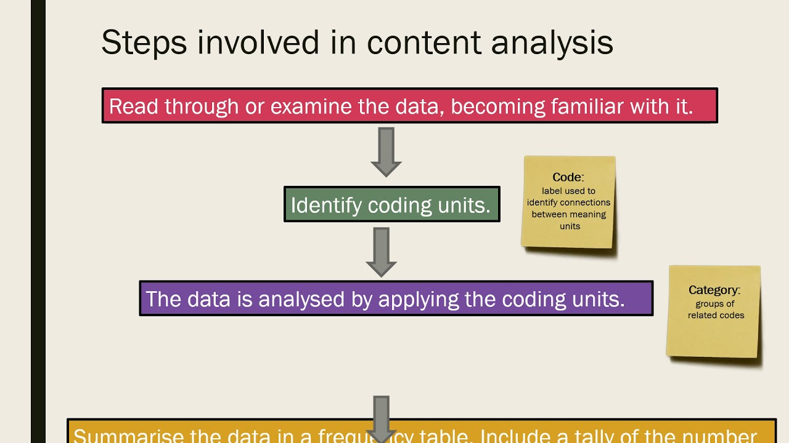
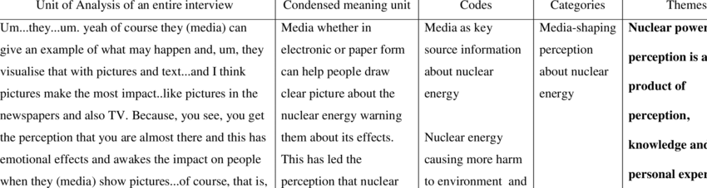
Qualitative data analysis methods - Content Analysis
youtube
Researchgate

Slide 10
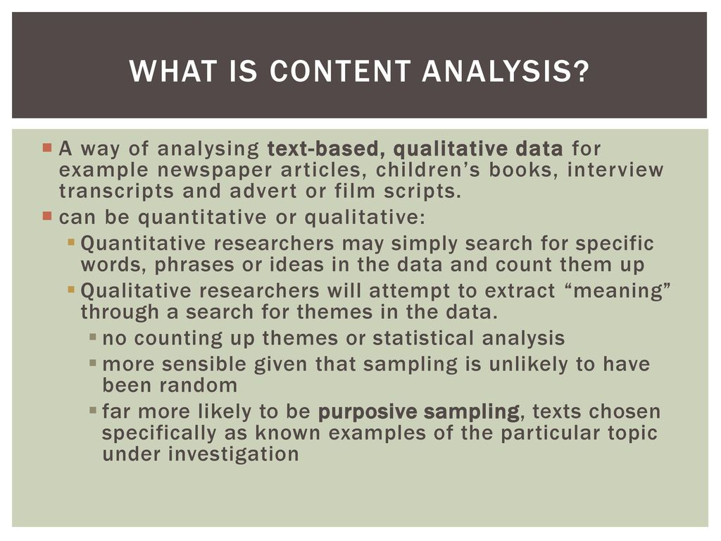
Johnston, 2019 via Slideplayer

Slide 11
Qualitative data analysis methods – Grounded theory
Grounded theory is used to generate theory from collected qualitative data.
It can be used as a standalone technique or as a research design.

Slide 12
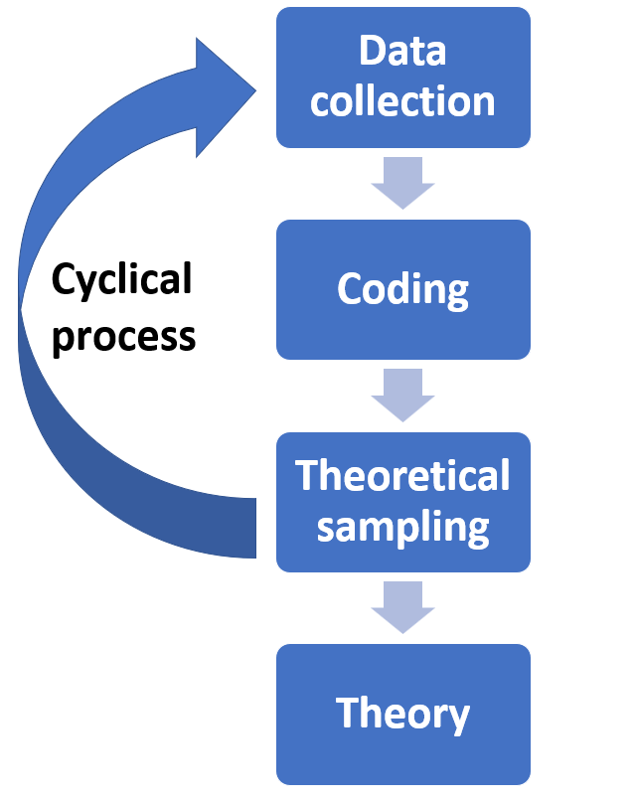
GT as a technique
Data collection from interview, observation, images, audio
recordings, voice recordings, narratives etc.
Transcribe the data into text format.
Data coding to identify certain patterns, categories and themes
Data collection again, only more targeted now that themes are in place
Data analysis and generate theory
Validate results to ensure replicability
Maxqda.com

Slide 13
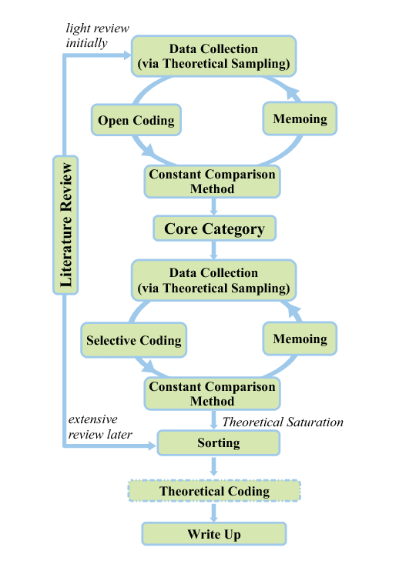
1
2
Researchgate

Slide 14
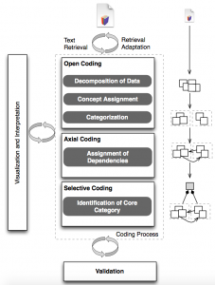
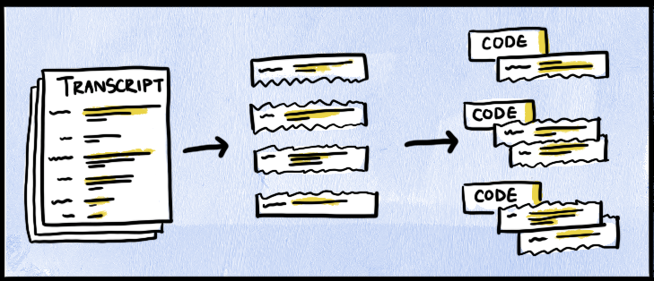
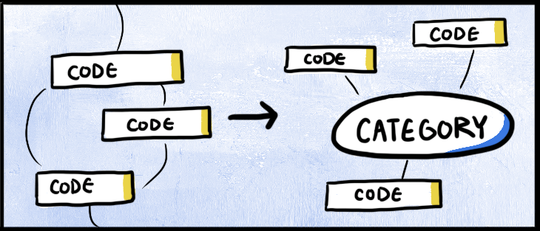
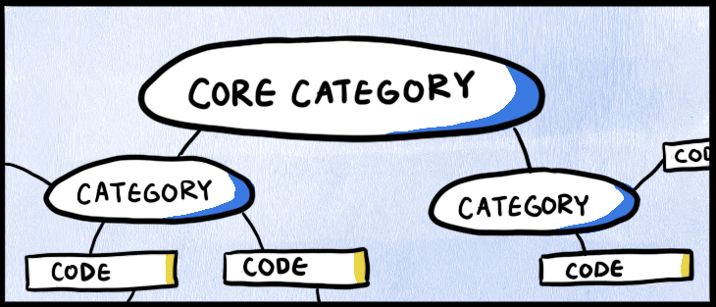
Coding
Three main steps to coding
Open coding: divide the transcripts into parts each uniquely labeled. “Open up”.
Axial coding: draw relationships between codes and organize them into categories. Create “axes” around which data can be grouped
Selective coding: categories are connected into one core category. This forms the theory and the contribution of the research.
Mendez, 2014
Devtool.com

Slide 15
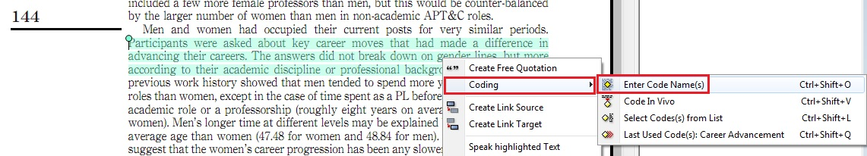
Software tools for support qualitative analysis include Nvivo and AtlasTi.
Researchgate

Slide 16
Participant | Response
Student 1 | The complexity is too much. From high school to first year the work is too much. The university must make a plan and sort us out with data. We need more data so we can work from residence and home.
Student 2 | I will make it better in programming if I can practice more. The time is not enough time in open access. My parents are not working and data is hard so I can’t practice from home and I stay very far from campus so I can’t travel late or on weekends.
Student 3 | We need more tuition. Our lecturers are not very good and they don’t understand that we need time to learn and get used to programming. It is not easy for us and first time is hard. Wifi is bad.

Slide 17
Open coding - create labels for the terms and concepts found in the data
Participant | Response
Student 1 | The complexity is too much. From high school to first year the work is too much. The university must make a plan and sort us out with data. We need more data so we can work from residence and home.
Student 2 | I will make it better in programming if I can practice more. The time is not enough time in open access. My parents are not working and data is hard so I can’t practice from home and I stay very far from campus so I can’t travel late or on weekends.
Student 3 | We need more tuition. Our lecturers are not very good and they don’t understand that we need time to learn and get used to programming. It is not easy for us and first time is hard. Wifi is bad.

Slide 18
Participant | Response | Open coding
Student 1 | The complexity is too much. From high school to first year the work is too much. The university must make a plan and sort us out with data. We need more data so we can work from residence and home. | Work complexity is high Need for data
Student 2 | I will make it better in programming if I can practice more. The time is not enough time in open access. My parents are not working and data is hard so I can’t practice from home and I stay very far from campus so I can’t travel late or on weekends. | More practice in programming Limited open access (computer labs?) No data at home
Student 3 | We need more tuition. Our lecturers are not very good and they don’t understand that we need time to learn and get used to programming. It is not easy for us and first time is hard. Wifi is bad. | More tuition Poor lecturers Difficult for first years Wifi (connectivity) is poor

Slide 19
Axial coding - identification of more important codes and those codes that can be combined.
Open coding
Work complexity is high Need for data
More practice in programming Limited open access (computer labs?) No data at home
More tuition Poor lecturers Difficult for first years Wifi (connectivity) is poor
Work complexity; more practice with programming; difficulty
Available Data
Access to labs
Lecturers
Tutors
wifi
importance

Slide 20
Participant | Response | Open coding | Axial coding
Student 1 | The complexity is too much. From high school to first year the work is too much. The university must make a plan and sort us out with data. We need more data so we can work from residence and home. | Work complexity is high Need for data | A difficulty in adapting to required level of study A need to provide more connectivity options Faculty capacity building
Student 2 | I will make it better in programming if I can practice more. The time is not enough time in open access. My parents are not working and data is hard so I can’t practice from home and I stay very far from campus so I can’t travel late or on weekends. | More practice in programming Limited open access (computer labs?) No data at home
Student 3 | We need more tuition. Our lecturers are not very good and they don’t understand that we need time to learn and get used to programming. It is not easy for us and first time is hard. Wifi is bad. | More tuition Poor lecturers Difficult for first years Wifi (connectivity) is poor

Slide 21
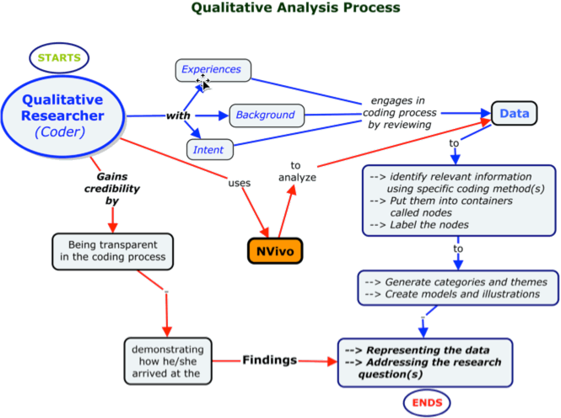
Nvivo.com

Slide 22
Analysing quantitative data
Quantitative data analysis involves numbers
Collected data has to be transformed into numerical format
This data should be cleaned and arranged
Thereafter, analysis may be performed using statistics and other mathematical methods

Slide 23
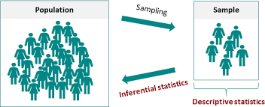
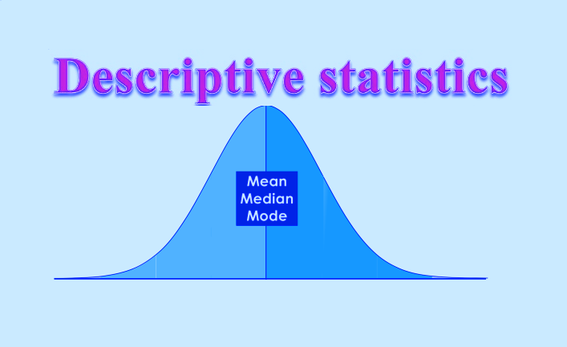
Statistics
Is concerned with describing, interpreting and analyzing numerical data
There are two main types of statistics, descriptive and inferential.
Descriptive statistics aims to describe the data e.g. average mark
Inferential statistics prove that the results are genuine i.e. not fake or doctored and that the results can be generalized to the population.
Datadriveninvestor.com
Datatab.net

Slide 24
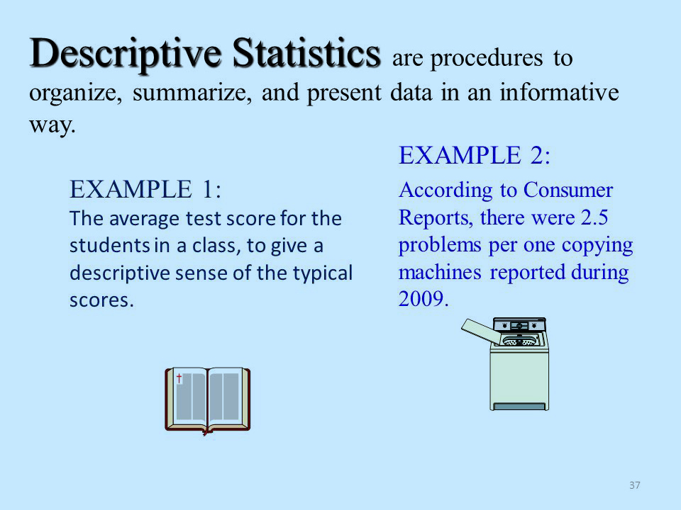
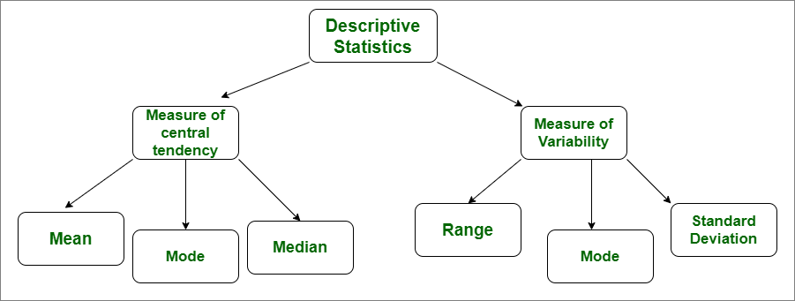
1. Descriptive statistics
Descriptive statistics is used to organize, summarize and describe data.
Two categories
dataflair
Geeksforgeeks

Slide 25
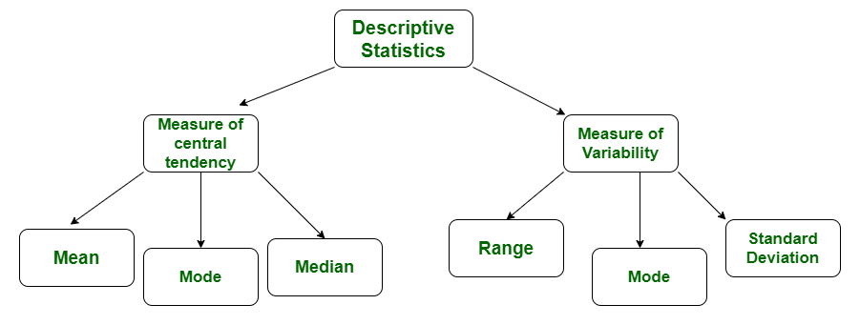
Mean – average of a range of numbers
Median – middle point of a range of numbers (if those numbers sorted)
Mode – the number that appears most often
Range – the difference between the largest and the smallest number
Standard deviation and variance – these indicate how dispersed a range of numbers are. In other words, how close (or far) all the numbers are to (or from) the mean.

Slide 26
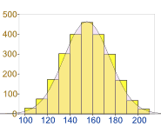

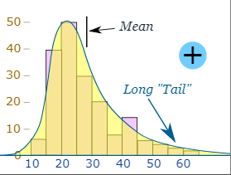
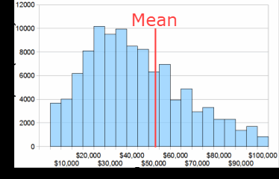
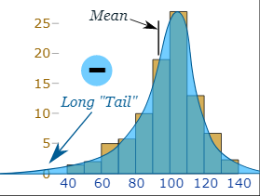
Skewness
Skewness shows the distribution of data from the mean
Normal distribution – Bell curve, little to no skew
Positive skew
Negative skew
SKEW function in Excel
Linear models work on the assumption that the distribution of the independent variable and the target variable are similar. Therefore, knowing about the skewness of data helps in creating better linear models (https://www.analyticsvidhya.com/)
Mathsisfun.com

Slide 27
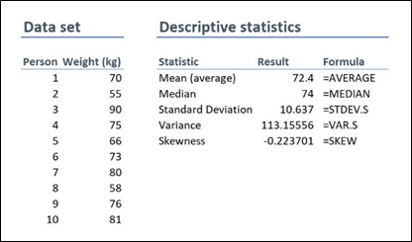
Jason and Warren, 2020

Slide 28
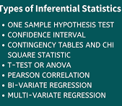
2. Inferential Statistics
Inferential statistics allow for the researcher to make inferences about the population but based on the sample.

Slide 29
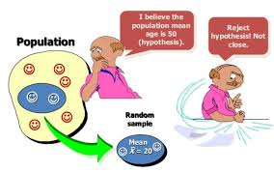
Hypothesis testing
One type of Inferential statistics is hypothesis testing. Based on the examples above, a hypothesis might be stated as
H1o: There is no difference is marks between those students with laptops and those without
H1a: There is a difference in marks between those students with laptops and those without
Statistics inform the researcher which hypothesis is true and which are false.

Slide 30
The hypothesis is written as a statement:
If I <do this to an independent variable>
then
<it will result in this change to the dependent variable>
e.g.
If the <computer laboratory time is increased>
then the
<final mark for programming module will increase>

Slide 31
The researcher develops a hypothesis and a null-hypothesis
Null hypothesis
  H₀
  the assumption that nothing will change
Alternative Hypothesis
  H₁
  is some other hypothesis that is, the opposite of the null hypothesis.
You tube

Slide 32
the researcher believes that the current average final mark of 65% can be improved if lab time is increased
Hypothesis as below. The null (H₀) must be rejected.
  H₀: average final mark = 65% (no change)
  H₁: average final mark > 65% (increase)
The researcher must choose the most appropriate statistical test to reject the null hypothesis

Slide 33
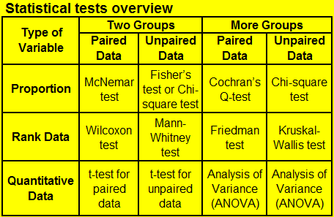
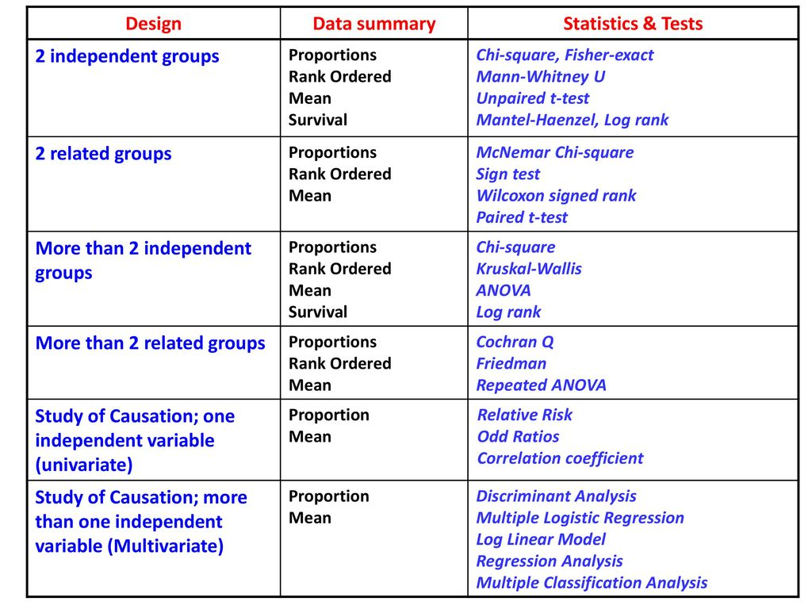
Ecstep.com

Slide 34
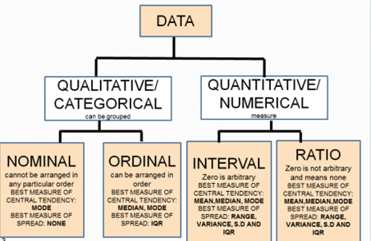
Before a choice of statistical technique can be made, the researcher needs to understand the different types of data that they are working with.
Ragunath, 2019

Slide 35
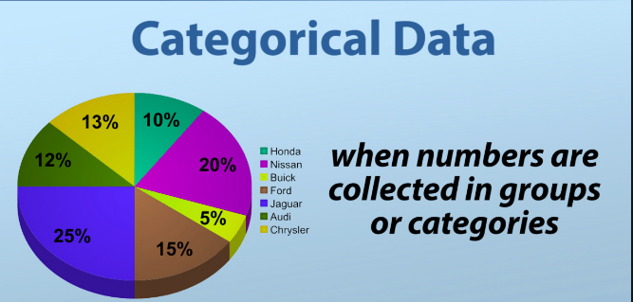
Categorical data must belong to a category first before being assigned a numerical format.
For example,
final mark between 0 and 50 is category 1,
between 49 and 60 is category 2, and
between 59 and 101 is category 3.
In other words, the final marks of all students have been placed into categories and assigned a numerical value of either 1, 2 or 3.

Slide 36
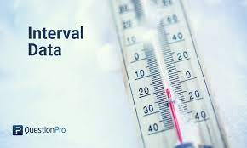
Interval data naturally exists as numbers (for example final mark). Interval data has a ranking and the options are equally spaced apart.
Zero point is arbitrary that is, a zero is a value and not a null or missing value.
Consider a temperature reading: -2; -1; 0; 1; 2. Zero temperature is an actual data value and the options are equally spaced apart.

Slide 37

Ratio data is similar to interval data with the exception that a zero value means no or null instances of that option.
Stated differently, zero means that there is nothing of that variable in the sample.
Ratio data is evenly spaced and it is ranked.
How many Blue dots are in the sample?

Slide 38
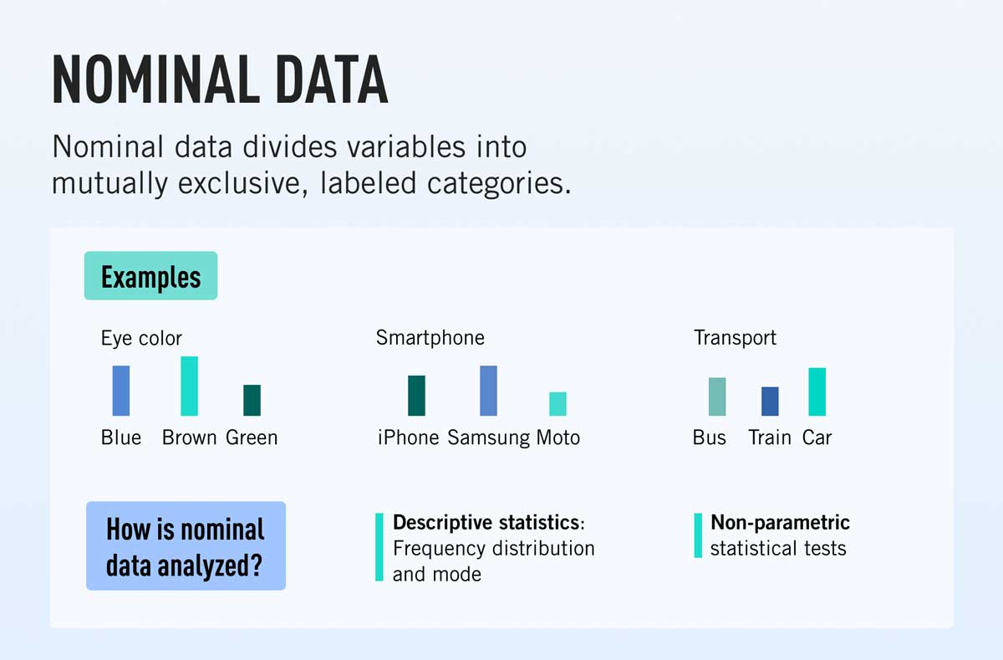
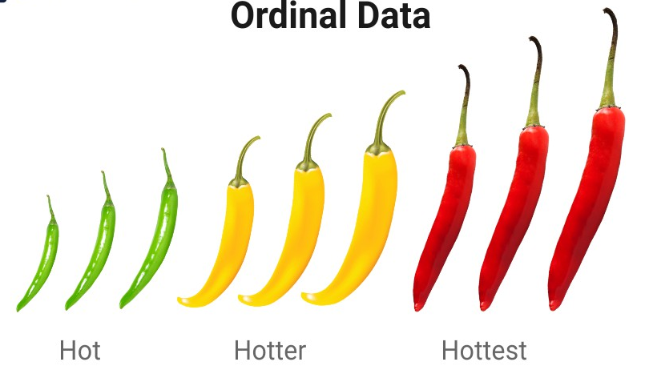
Categorical data can be either ordinal or nominal.
Nominal data does not have a ranking or natural order. All data are equal but different. For example, data about gender, race and marital status do not have a ranking and one response cannot be better than the other.
Ordinal data does have a ranking and a difference. For example, level of agreement can be “disagree, neutral or agree”. The data collected for level of agreement is a category but, the difference between the options (disagree, agree and neutral) cannot be numerically measured. They can be ordered and logically ranked.
Careerfoundry.com
QuestionPro

Slide 39
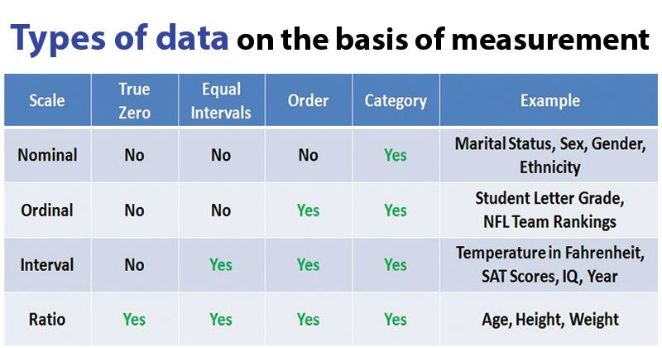
Microbe Notes

Slide 40
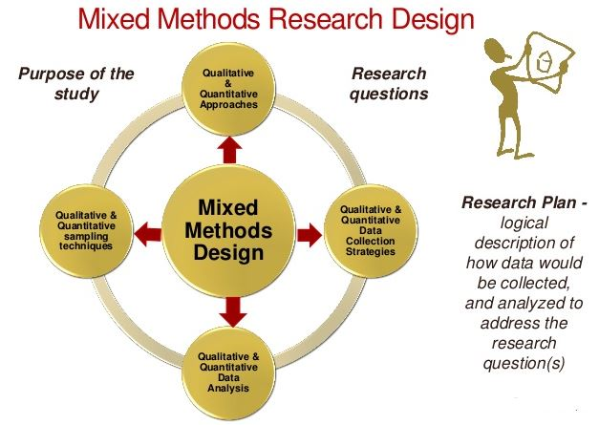
Mixed methods
As the name suggests, a combination of qualitative and quantitative analysis
Qualitative data can be sorted and arranged into categories which can then be assigned numerical values
Thereafter, statistical analysis can be performed on the data
Studyaids.co.uk

Slide 41
Please read the lecture note for this section.
Available on Moodle.
Questions and comments are welcome: alveens@dut.ac.za

